Slide 1



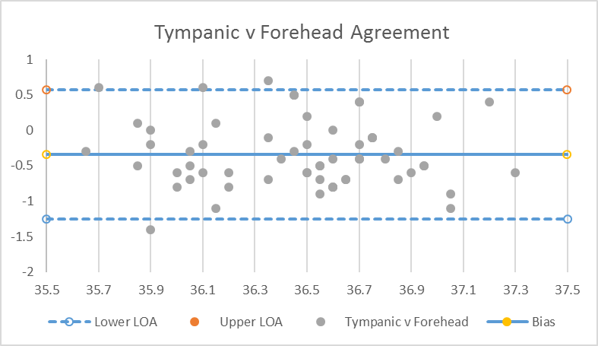
Patient Temperature Checking in COVID-Era ENT Clinic: Can We Trust Cutaneous Thermometers?
Dr Megan Allman¹, Dr Matthew McKenna², Rosie Vista³, Mr Steven Backhouse⁴
ENT Department, Princess of Wales Hospital
BACKGROUND
OBJECTIVE
The Covid-19 pandemic continues to prevent UK hospitals from running at normal capacity. It has resulted in severe restrictions on non-emergency and elective care. Therefore, systems have had to adapt to allow hospital services to resume safely.
Patients now have their temperature checked for pyrexia prior to their face-to-face clinic appointment. Priorities in the outpatient setting are on quick, easy to perform and non-invasive methods of temperature measurement.
To assess the concordance between temperature measurements taken using infrared tympanic and infrared cutaneous thermometers, on patients attending ENT outpatient clinic in Princess of Wales Hospital.
METHODS
Rectal and oral thermometers give the best estimate for core body temperature, however they are less acceptable to patients and risk contamination with Covid-19 via contact with bodily fluids^{1,2}. Tympanic thermometers are often used as a surrogate marker for body temperature². Infrared cutaneous thermometers may also be considered as they do not require any direct contact with the patient³.
63 consecutive patients attending ENT Clinic in Princess of Wales Hospital
Temperature measured using both infrared tympanic and cutaneous thermometers
Agreement between methods was tested using Bland-Altman plot and Paired T-Test
RESULTS
3 patient readings were excluded from analysis due to erroneous extreme low temperature measurements on the cutaneous thermometer (28.4°c, 32.8°c, 33.5°c), as these were not compatible with life.
There were no recorded pyrexia (>37.8°c) in the 60 patients.
Bland-Altman Agreement
.
The graph demonstrates reasonable agreement of the two methods (limits of agreement -1.25°c to 0.57°c)
Mean difference of -0.34°c indicates the presence of a fixed bias of the cutaneous thermometer to measure lower than the tympanic thermometer
Disagreement between the two methods was greater at higher and lower temperatures
Thermometer | No. | Mean | 95% CI
Cutaneous | 60 | 36.3°c | 36.2°c - 36.4°c
Tympanic | 60 | 36.6°c | 36.5°c - 36.7°c
The cutaneous thermometer measured on average 0.34°c lower than the tympanic thermometer.
The difference in measurements was statistically significant (P<0.05).
References
DISCUSSION/CONCLUSION
1. Bijur PE, Shah PD, Esses D. Temperature measurement in the adult emergency department: oral, tympanic membrane and temporal artery temperatures versus rectal temperature. Emerg Med J. 2016;33(12):843-847. doi:10.1136/emermed-2015-205122
2. Liu CC, Chang RE, Chang WC. Limitations of forehead infrared body temperature detection for fever screening for severe acute respiratory syndrome. Infect Control Hosp Epidemiol. 2004;25(12):1109-1111. doi:10.1086/502351
3. Sener, Serkana; Karcioglu, Ozgurb; Eken, Cenkerc; Yaylaci, Serpila; Ozsarac, Muratd Agreement between axillary, tympanic, and mid-forehead body temperature measurements in adult emergency department patients, European Journal of Emergency Medicine: August 2012 - Volume 19 - Issue 4 - p 252-256 doi: 10.1097/MEJ.0b013e32834c5841
4. Asadian S, Khatony A, Moradi G, Abdi A, Rezaei M. Accuracy and precision of four common peripheral temperature measurement methods in intensive care patients. Med Devices (Auckl). 2016;9:301-308. Published 2016 Sep 1. doi:10.2147/MDER.S109904
5. Teller J, Ragazzi M, Simonetti GD, Lava SA. Accuracy of tympanic and forehead thermometers in private paediatric practice. Acta Paediatr. 2014;103(2):e80-e83. doi:10.1111/apa.12464
.
The aim of patient temperature checking is to detect pyrexia and therefore prevent spread of coronavirus. Whilst infrared cutaneous thermometers may seem appealing due to convenience and non-contact, they may be more prone to false negatives when assessing for patient pyrexia. Therefore, the widespread use of cutaneous thermometers may undermine efforts to prevent spread of coronavirus, by its propensity to measure lower than the tympanic thermometer.
The cutaneous thermometer may also be less reliable, as it was more susceptible to extreme aberrant readings. Whilst it could be argued that the observed differences are user-dependent, the risk of missing patient pyrexia by using the cutaneous thermometer in this context still remains.
The findings in this study are in keeping with available literature on the topic^{4,5}.

