Slide 1

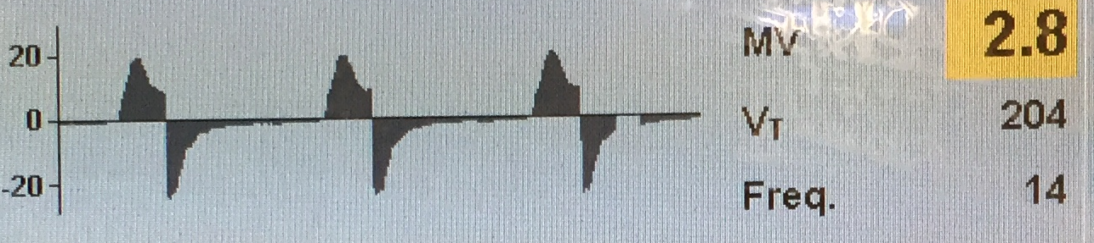
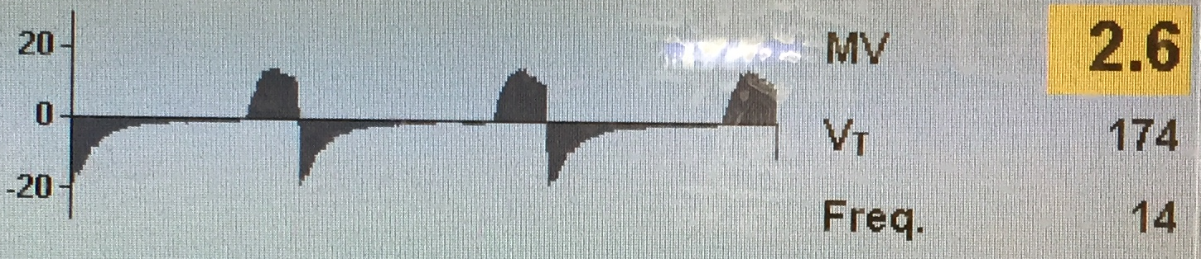
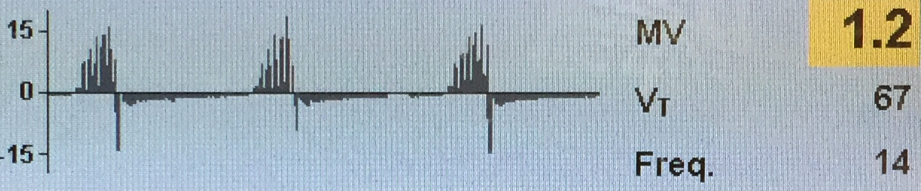
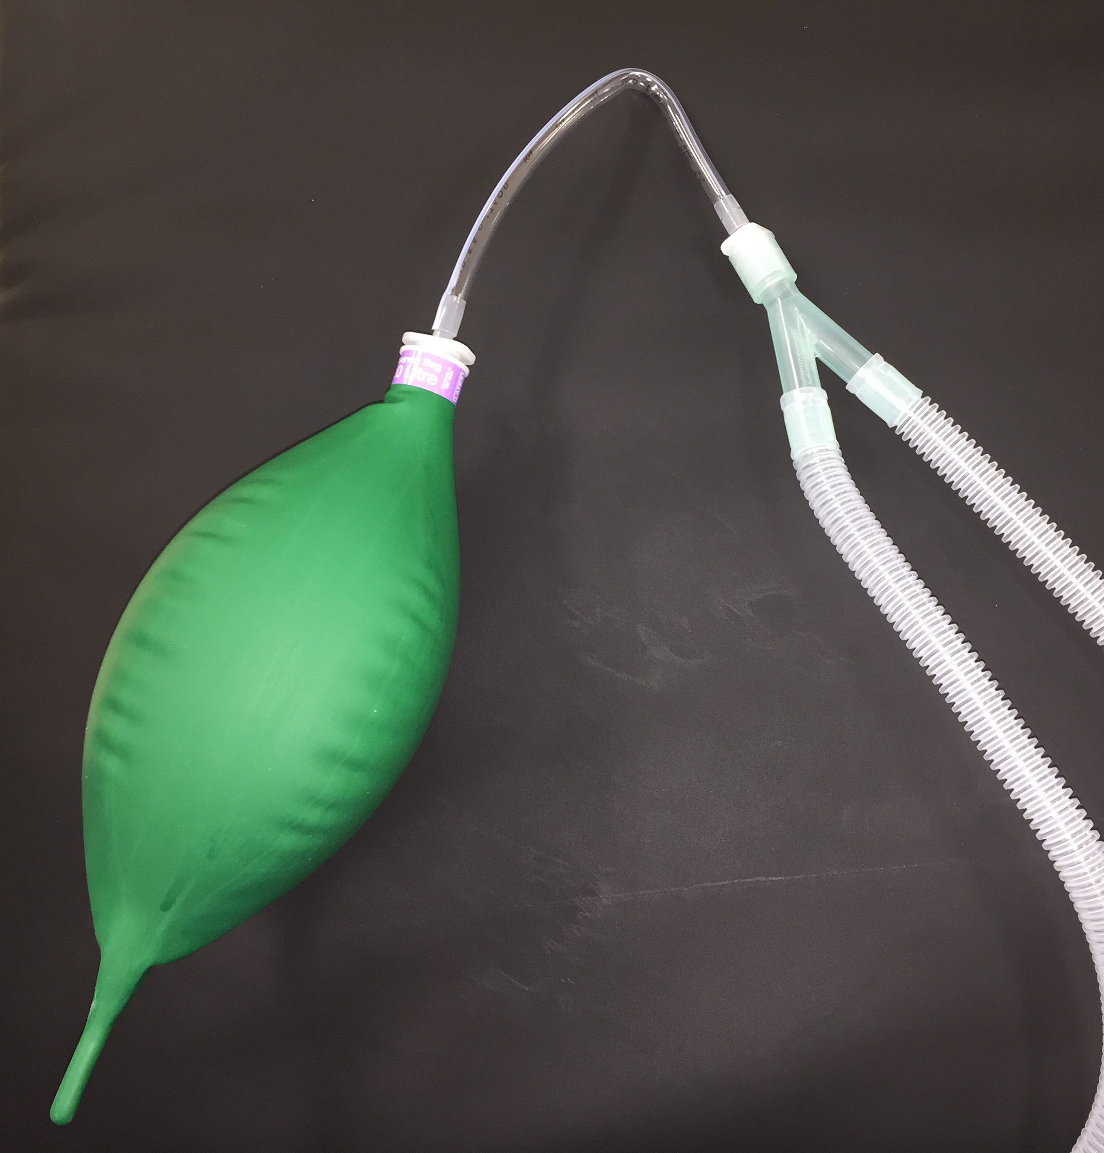
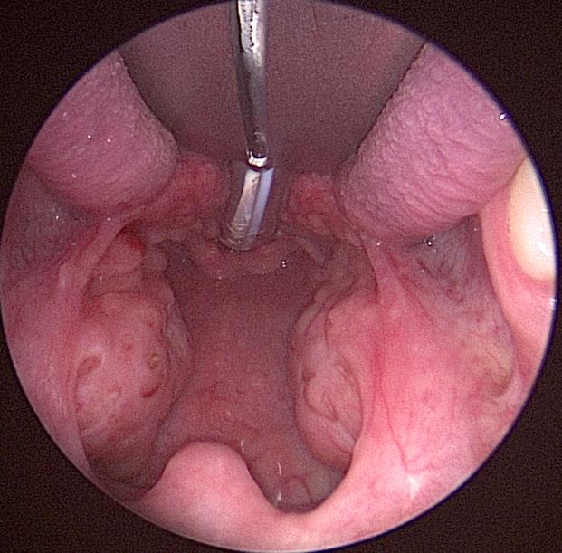
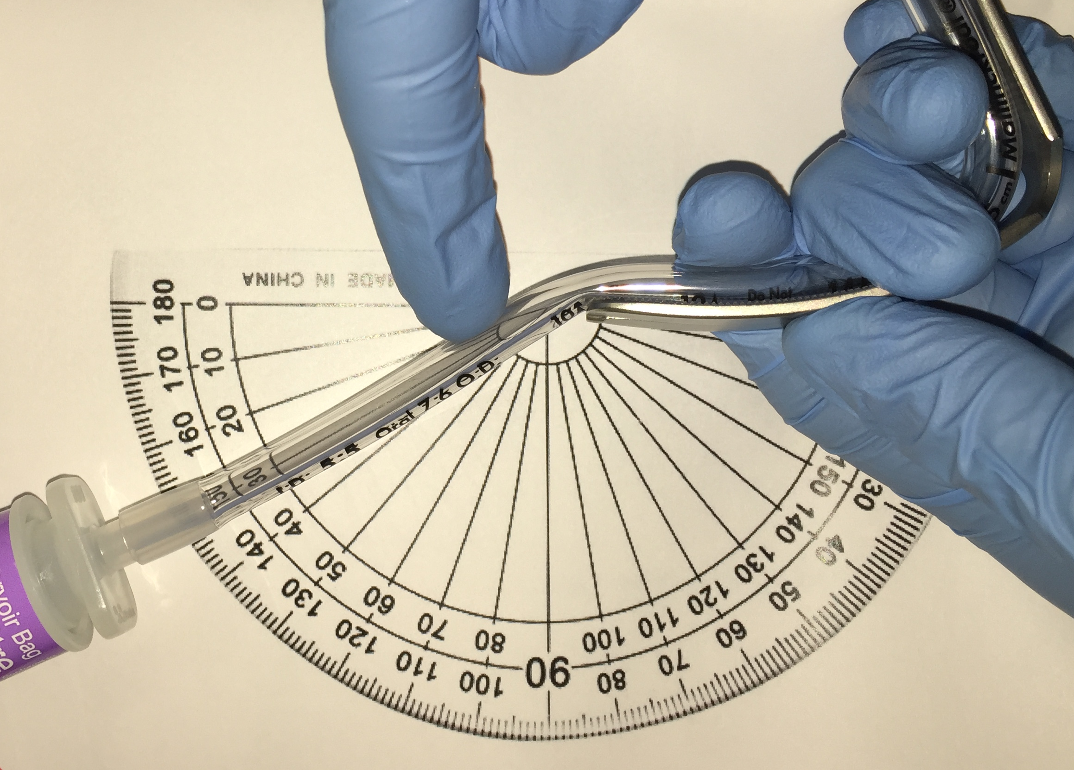
An In-Vitro study of Endotracheal tube function related to tonsillar gag compression – too kinky?
J. Howard H. Whittet
Selection of an inappropriate blade for the Boyle-Davis gag during tonsillectomy can result in the endotracheal tube (ETT) becoming kinked or compromised, usually at the base of the tongue. This may not be immediately recognised and can potentially place a patient at risk. As a result we decided to investigate the relation of airway obstruction to the degree of bending of an ETT.
No significant change was noted in tidal volume at degrees of bend up to 45⁰. Beyond this the flow decreased markedly in an approximately linear fashion. Beyond 60⁰ the peak pressure also increased despite being set on the machine, possibly related to the high degree of obstruction. An obstructive morphology (flattening) was noted on the flow-loop from 60⁰ and a saw-tooth pattern from 75⁰ (shown to the right). This pattern has been noted elsewhere related to luminal obstruction¹.
30⁰
60⁰
90⁰
A reassuring (and perhaps surprisingly) high tolerance to bending was noted given that changes in the tidal volume and flow loop only occurred at degrees of bend beyond 45⁰. Beyond this there is a linear reduction with 50% reduction in tidal volume at >80⁰ bend.
The increase in peak pressure despite this being limited on the anaesthetic machine is also a concern as this could result in further barotrauma to compound the ventilatory difficulty.
A high index of suspicion is still required to ensure early recognition of this situation and prevent patient harm.
A 5.5mm inner diameter Rae ETT was connected to simulated lungs (a ventilation balloon) and ventilated with a standard anaesthetic circuit using a pressure-controlled program (peak inspiratory pressure 15 cm H₂O, 14 breaths per minute). The tidal volume, flow pattern and pressures were recorded as the Rae tube was serially bent through 15⁰ increments.
References:
Neukirch F, Weitzenblum E, Liard R, et al. Frequency and correlates of the saw-tooth pattern of flow-volume curves in an epidemiological survey. Chest. 1992;101(2):425-31.

